Slide 1
Chapter 15 : Concurrency Control

Slide 2
Chapter 15: Concurrency Control
Lock-Based Protocols
Timestamp-Based Protocols
Validation-Based Protocols
Multiple Granularity
Multiversion Schemes
Insert and Delete Operations
Concurrency in Index Structures

Slide 3
Lock-Based Protocols
A lock is a mechanism to control concurrent access to a data item
Data items can be locked in two modes:
1. exclusive (X) mode. Data item can be both read as well as
written. X-lock is requested using lock-X instruction.
2. shared (S) mode. Data item can only be read. S-lock is
requested using lock-S instruction.
Lock requests are made to concurrency-control manager. Transaction can proceed only after request is granted.

Slide 4
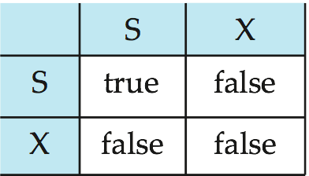
Lock-Based Protocols (Cont.)
Lock-compatibility matrix
A transaction may be granted a lock on an item if the requested lock is compatible with locks already held on the item by other transactions.
Any number of transactions can hold shared locks on an item,
  but if any transaction holds an exclusive on the item no other transaction may hold any lock on the item.
If a lock cannot be granted, the requesting transaction is made to wait till all incompatible locks held by other transactions have been released. The lock is then granted.

Slide 5
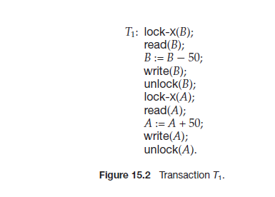

Slide 6
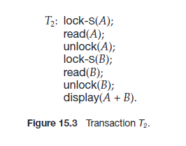

Slide 7
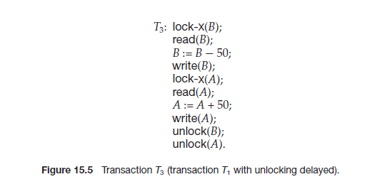

Slide 8
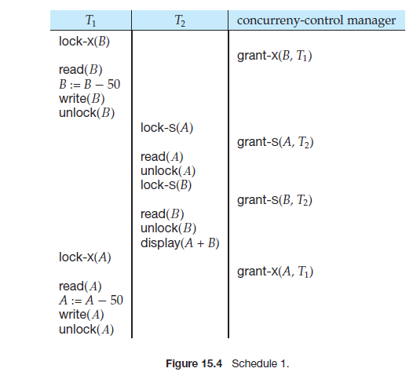

Slide 9
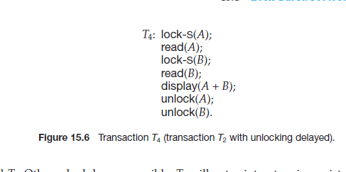

Slide 10
Lock-Based Protocols (Cont.)
Example of a transaction performing locking:
T₂: lock-S(A);
read (A);
unlock(A);
lock-S(B);
read (B);
unlock(B);
display(A+B)
Locking as above is not sufficient to guarantee serializability — if A and B get updated in-between the read of A and B, the displayed sum would be wrong.
A locking protocol is a set of rules followed by all transactions while requesting and releasing locks. Locking protocols restrict the set of possible schedules.

Slide 11

Pitfalls of Lock-Based Protocols
Consider the partial schedule
Neither T₃ nor T₄ can make progress — executing lock-S(B) causes T₄ to wait for T₃ to release its lock on B, while executing lock-X(A) causes T₃ to wait for T₄ to release its lock on A.
Such a situation is called a deadlock.
  To handle a deadlock one of T₃ or T₄ must be rolled back
  and its locks released.

Slide 12
Pitfalls of Lock-Based Protocols (Cont.)
The potential for deadlock exists in most locking protocols. Deadlocks are a necessary evil.
Starvation is also possible if concurrency control manager is badly designed. For example:
  A transaction may be waiting for an X-lock on an item, while a sequence of other transactions request and are granted an S-lock on the same item.
  The same transaction is repeatedly rolled back due to deadlocks.
Concurrency control manager can be designed to prevent starvation.

Slide 13
The Two-Phase Locking Protocol
This is a protocol which ensures conflict-serializable schedules.
Phase 1: Growing Phase
  transaction may obtain locks
  transaction may not release locks
Phase 2: Shrinking Phase
  transaction may release locks
  transaction may not obtain locks
The protocol assures serializability.
It can be proved that the transactions can be serialized in the order of their lock points (i.e., the point where a transaction acquired its final lock).

Slide 14
T1 T2
Lock S(A)
Lock S(A)
Lock X(B)
Unlock(A)
Lock S(D)
Unlock(B)
Unlock(A)
Unlock (D)

Slide 15
The Two-Phase Locking Protocol (Cont.)
Two-phase locking does not ensure freedom
  Irrecoverabiltity
  Deadlocks
  cascading roll backs
To avoid this, follow a modified protocol called strict two-phase locking. Here a transaction must hold all its exclusive locks till it commits/aborts.
Rigorous two-phase locking is even stricter: here all locks are held till commit/abort. In this protocol transactions can be serialized in the order in which they commit.

Slide 16
The Two-Phase Locking Protocol (Cont.)
There can be conflict serializable schedules that cannot be obtained if two-phase locking is used.
However, in the absence of extra information (e.g., ordering of access to data), two-phase locking is needed for conflict serializability in the following sense:
Given a transaction T_{i} that does not follow two-phase locking, we can find a transaction T_{j} that uses two-phase locking, and a schedule for T_{i} and T_{j} that is not conflict serializable.

Slide 17
Lock Conversions
Two-phase locking with lock conversions:
– First Phase:
  can acquire a lock-S on item
  can acquire a lock-X on item
  can convert a lock-S to a lock-X (upgrade)
– Second Phase:
  can release a lock-S
  can release a lock-X
  can convert a lock-X to a lock-S (downgrade)
This protocol assures serializability. But still relies on the programmer to insert the various locking instructions.

Slide 18
Automatic Acquisition of Locks
A transaction T_{i} issues the standard read/write instruction, without explicit locking calls.
The operation read(D) is processed as:
if T_{i} has a lock on D
then
read(D)
else begin
if necessary wait until no other
transaction has a lock-X on D
grant T_{i} a lock-S on D;
read(D)
end

Slide 19
Automatic Acquisition of Locks (Cont.)
write(D) is processed as:
if T_{i} has a lock-X on D
then
write(D)
else begin
if necessary wait until no other trans. has any lock on D,
if T_{i} has a lock-S on D
then
upgrade lock on D to lock-X
else
grant T_{i} a lock-X on D
write(D)
end;
All locks are released after commit or abort

Slide 20
Implementation of Locking
A lock manager can be implemented as a separate process to which transactions send lock and unlock requests.
The lock manager replies to a lock request by sending a lock grant messages (or a message asking the transaction to roll back, in case of a deadlock).
The requesting transaction waits until its request is answered.
The lock manager maintains a data-structure called a lock table to record granted locks and pending requests.
The lock table is usually implemented as an in-memory hash table indexed on the name of the data item being locked.

Slide 21
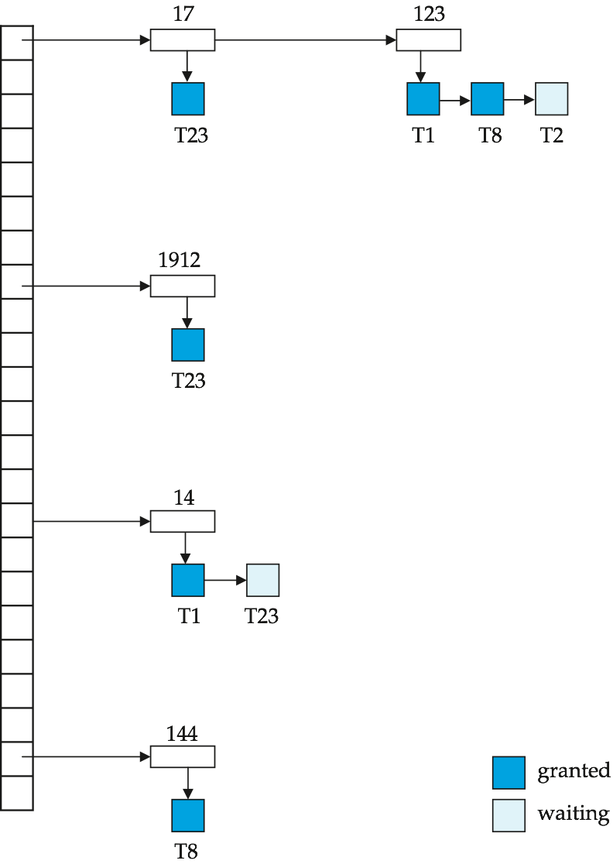
Lock Table
Black rectangles indicate granted locks, white ones indicate waiting requests
Lock table also records the type of lock granted or requested
New request is added to the end of the queue of requests for the data item, and granted if it is compatible with all earlier locks
Unlock requests result in the request being deleted, and later requests are checked to see if they can now be granted
If transaction aborts, all waiting or granted requests of the transaction are deleted
  lock manager may keep a list of locks held by each transaction, to implement this efficiently

Slide 22
Graph-Based Protocols
Graph-based protocols are an alternative to two-phase locking.
Impose a partial ordering → on the set D = {d₁, d₂ ,..., d_{h}} of all data items.
  If d_{i} → d_{j} then any transaction accessing both d_{i} and d_{j} must access d_{i} before accessing d_{j}.
  Implies that the set D may now be viewed as a directed acyclic graph, called a database graph.
The tree-protocol is a simple kind of graph protocol.

Slide 23
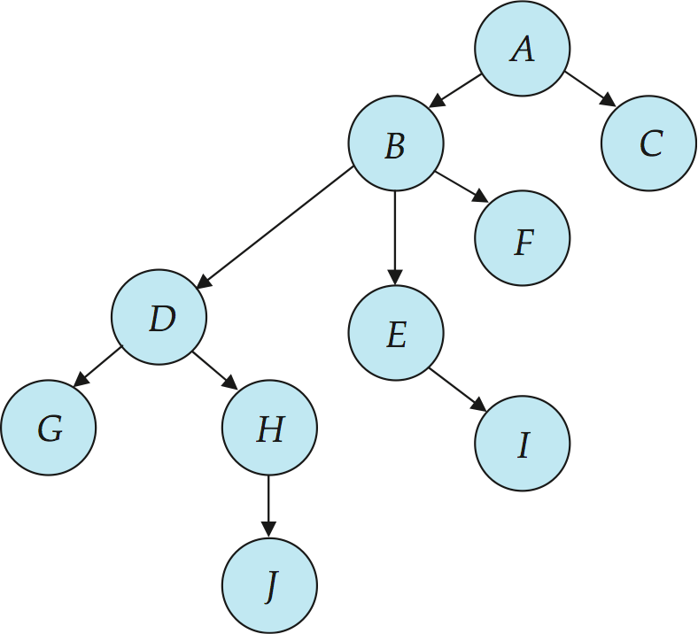
Tree Protocol
Only exclusive locks are allowed.
The first lock by T_{i} may be on any data item. Subsequently, a data Q can be locked by T_{i} only if the parent of Q is currently locked by T_{i}.
Data items may be unlocked at any time.
A data item that has been locked and unlocked by T_{i} cannot subsequently be relocked by T_{i} .

Slide 24
Graph-Based Protocols (Cont.)
The tree protocol ensures conflict serializability as well as freedom from deadlock.
Unlocking may occur earlier in the tree-locking protocol than in the two-phase locking protocol.
  shorter waiting times, and increase in concurrency
  protocol is deadlock-free, no rollbacks are required
Drawbacks
  Protocol does not guarantee recoverability or cascade freedom
    Need to introduce commit dependencies to ensure recoverability
  Transactions may have to lock data items that they do not access.
    increased locking overhead, and additional waiting time
    potential decrease in concurrency
Schedules not possible under two-phase locking are possible under tree protocol, and vice versa.

Slide 25

Deadlock Handling
Consider the following two transactions:
T₁: write (X) T₂: write(Y)
write(Y) write(X)
Schedule with deadlock

Slide 26
Deadlock Handling
System is deadlocked if there is a set of transactions such that every transaction in the set is waiting for another transaction in the set.
Deadlock prevention protocols ensure that the system will never enter into a deadlock state. Some prevention strategies:
  Require that each transaction locks all its data items before it begins execution (predeclaration).
  Impose partial ordering of all data items and require that a transaction can lock data items only in the order specified by the partial order (graph-based protocol).

Slide 27
Multiple Granularity
Allow data items to be of various sizes and define a hierarchy of data granularities, where the small granularities are nested within larger ones.
Can be represented graphically as a tree (but don't confuse with tree-locking protocol)
When a transaction locks a node in the tree explicitly, it implicitly locks all the node's descendents in the same mode.
Granularity of locking (level in tree where locking is done):
  fine granularity (lower in tree): high concurrency, high locking overhead
  coarse granularity (higher in tree): low locking overhead, low concurrency

Slide 28
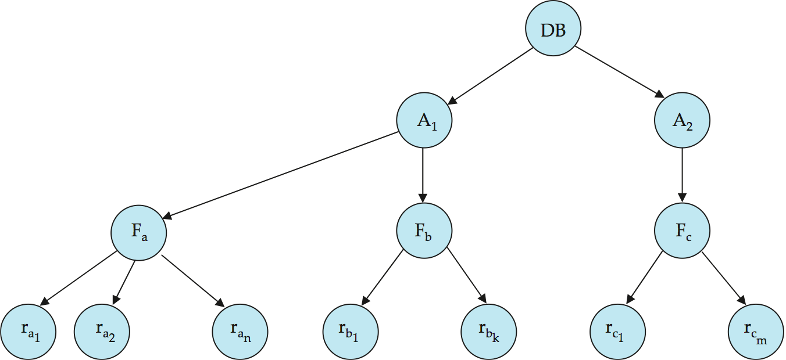
Example of Granularity Hierarchy
The levels, starting from the coarsest (top) level are:
  database
  area
  file
  record

Slide 29
Intention Lock Modes
In addition to S and X lock modes, there are three additional lock modes with multiple granularity:
  intention-shared (IS): indicates explicit locking at a lower level of the tree but only with shared locks.
  intention-exclusive (IX): indicates explicit locking at a lower level with exclusive or shared locks
  shared and intention-exclusive (SIX): the subtree rooted by that node is locked explicitly in shared mode and explicit locking is being done at a lower level with exclusive-mode locks.
Intention locks allow a higher level node to be locked in S or X mode without having to check all descendent nodes.

Slide 30
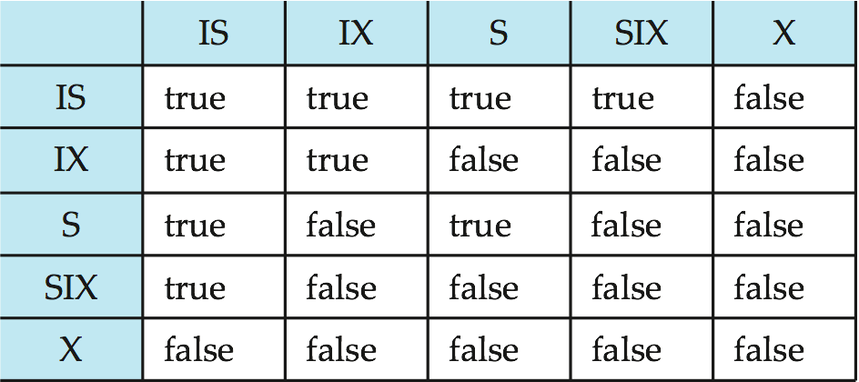
Compatibility Matrix with Intention Lock Modes
The compatibility matrix for all lock modes is:

Slide 31
Multiple Granularity Locking Scheme
Transaction T_{i} can lock a node Q, using the following rules:
  The lock compatibility matrix must be observed.
  The root of the tree must be locked first, and may be locked in any mode.
  A node Q can be locked by T_{i} in S or IS mode only if the parent of Q is currently locked by T_{i} in either IX or IS mode.
  A node Q can be locked by T_{i} in X, SIX, or IX mode only if the parent of Q is currently locked by T_{i} in either IX or SIX mode.
  T_{i} can lock a node only if it has not previously unlocked any node (that is, T_{i} is two-phase).
  T_{i} can unlock a node Q only if none of the children of Q are currently locked by T_{i}.
Observe that locks are acquired in root-to-leaf order, whereas they are released in leaf-to-root order.

Slide 32
Timestamp-Based Protocols
Unique value assigned to every transaction
Tells order when transaction enters in system
RTS
WTS

Slide 33
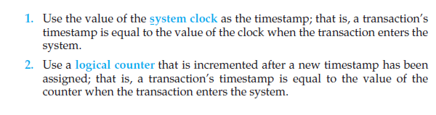
Implementing TS

Slide 34
Timestamp-Based Protocols
Each transaction is issued a timestamp when it enters the system. If an old transaction T_{i} has time-stamp TS(T_{i}), a new transaction T_{j} is assigned time-stamp TS(T_{j}) such that TS(T_{i}) <TS(T_{j}).
The protocol manages concurrent execution such that the time-stamps determine the serializability order.
In order to assure such behavior, the protocol maintains for each data Q two timestamp values:
  W-timestamp(Q) is the largest time-stamp of any transaction that executed write(Q) successfully.
  R-timestamp(Q) is the largest time-stamp of any transaction that executed read(Q) successfully.

Slide 35
Timestamp-Based Protocols (Cont.)
The timestamp ordering protocol ensures that any conflicting read and write operations are executed in timestamp order.
Suppose a transaction T_{i} issues a read(Q):
  If TS(T_{i}) ≤ W-timestamp(Q), then T_{i} needs to read a value of Q that was already overwritten.
    Hence, the read operation is rejected, and T_{i} is rolled back.
  If TS(T_{i})≥ W-timestamp(Q), then the read operation is executed, and R-timestamp(Q) is set to max(R-timestamp(Q), TS(T_{i})).

Slide 36
Timestamp-Based Protocols (Cont.)
Suppose that transaction T_{i} issues write(Q).
  If TS(T_{i}) < R-timestamp(Q), then the value of Q that T_{i} is producing was needed previously, and the system assumed that that value would never be produced.
    Hence, the write operation is rejected, and T_{i} is rolled back.
  If TS(T_{i}) < W-timestamp(Q), then T_{i} is attempting to write an obsolete value of Q.
    Hence, this write operation is rejected, and T_{i} is rolled back.
  Otherwise, the write operation is executed, and W-timestamp(Q) is set to TS(T_{i}).

Slide 37

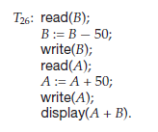

Slide 38
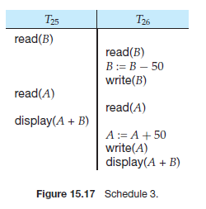

Slide 39

Example Use of the Protocol
A partial schedule for several data items for transactions with
timestamps 1, 2, 3, 4, 5

Slide 40

Correctness of Timestamp-Ordering Protocol
The timestamp-ordering protocol guarantees serializability since all the arcs in the precedence graph are of the form:
Thus, there will be no cycles in the precedence graph.
Timestamp protocol ensures freedom from deadlock as no transaction ever waits.
But the schedule may not be cascade-free, and may not even be recoverable.

Slide 41
Recoverability and Cascade Freedom
Problem with timestamp-ordering protocol:
  Suppose T_{i} aborts, but T_{j} has read a data item written by T_{i}
  Then T_{j} must abort; if T_{j} had been allowed to commit earlier, the schedule is not recoverable.
  Further, any transaction that has read a data item written by T_{j} must abort
  This can lead to cascading rollback --- that is, a chain of rollbacks
Solution 1:
  A transaction is structured such that its writes are all performed at the end of its processing
  All writes of a transaction form an atomic action; no transaction may execute while a transaction is being written
  A transaction that aborts is restarted with a new timestamp
Solution 2: Limited form of locking: wait for data to be committed before reading it
Solution 3: Use commit dependencies to ensure recoverability

Slide 42
Thomas’ Write Rule
Modified version of the timestamp-ordering protocol in which obsolete write operations may be ignored under certain circumstances.
When T_{i} attempts to write data item Q, if TS(T_{i}) < W-timestamp(Q), then T_{i} is attempting to write an obsolete value of {Q}.
  Rather than rolling back T_{i} as the timestamp ordering protocol would have done, this {write} operation can be ignored.
Otherwise this protocol is the same as the timestamp ordering protocol.
Thomas' Write Rule allows greater potential concurrency.
  Allows some view-serializable schedules that are not conflict-serializable.

Slide 43
Validation-Based Protocol
Execution of transaction T_{i} is done in three phases.
1. Read and execution phase: Transaction T_{i} writes only to
temporary local variables
2. Validation phase: Transaction T_{i} performs a ``validation test''
to determine if local variables can be written without violating
serializability.
3. Write phase: If T_{i} is validated, the updates are applied to the
database; otherwise, T_{i} is rolled back.
The three phases of concurrently executing transactions can be interleaved, but each transaction must go through the three phases in that order.
  Assume for simplicity that the validation and write phase occur together, atomically and serially
    i.e., only one transaction executes validation/write at a time.
Also called as optimistic concurrency control since transaction executes fully in the hope that all will go well during validation

Slide 44
Validation-Based Protocol (Cont.)
Each transaction T_{i} has 3 timestamps:
  Start(T_{i}) : the time when T_{i} started its execution
  Validation(T_{i}): the time when T_{i} entered its validation phase
  Finish(T_{i}) : the time when T_{i} finished its write phase
Serializability order is determined by timestamp given at validation time, to increase concurrency.
  Thus TS(T_{i}) is given the value of Validation(T_{i}).
This protocol is useful and gives greater degree of concurrency if probability of conflicts is low.
  because the serializability order is not pre-decided, and
  relatively few transactions will have to be rolled back.

Slide 45
Validation Test for Transaction T_{j}
If for all T_{i} with TS (T_{i}) < TS (T_{j}) either one of the following condition holds:
  finish(T_{i}) < start(T_{j})
  start(T_{j}) < finish(T_{i}) < validation(T_{j}) and the set of data items written by T_{i} does not intersect with the set of data items read by T_{j}.
then validation succeeds and T_{j} can be committed. Otherwise, validation fails and T_{j} is aborted.
Justification: Either the first condition is satisfied, and there is no overlapped execution, or the second condition is satisfied and
  the writes of T_{j} do not affect reads of T_{i} since they occur after T_{i} has finished its reads.
  the writes of T_{i} do not affect reads of T_{j} since T_{j} does not read any item written by T_{i}.

Slide 46

Schedule Produced by Validation
Example of schedule produced using validation

